Slide 1
Building recommendation system
Mohit Gupta, Runzhi Yang

Slide 2

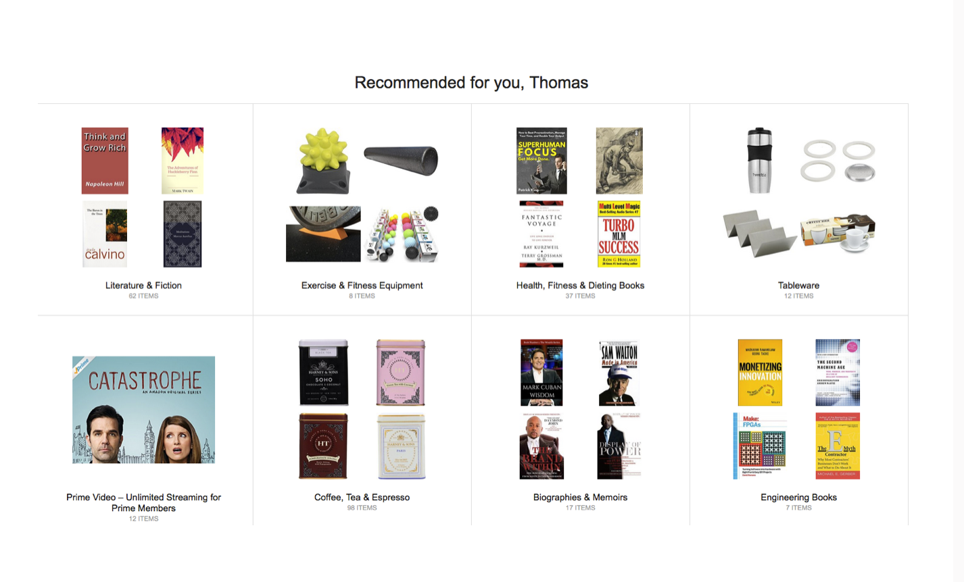

Why recommendation system

Slide 3
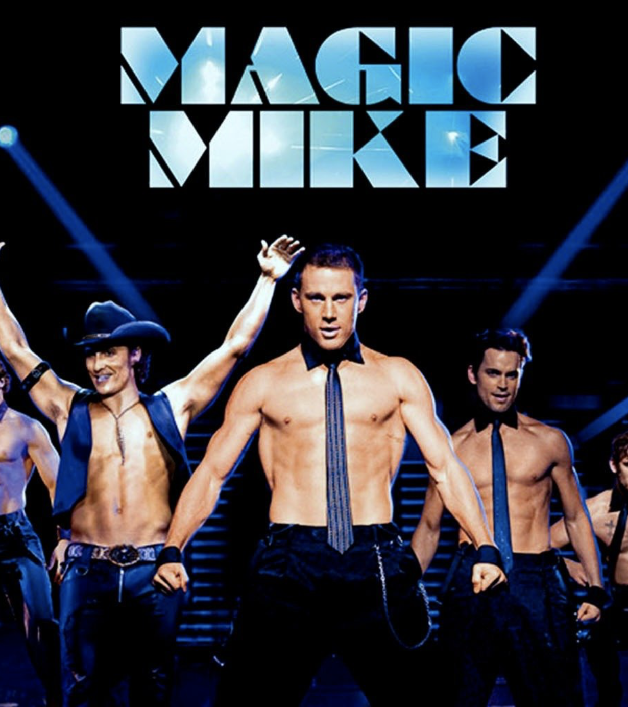
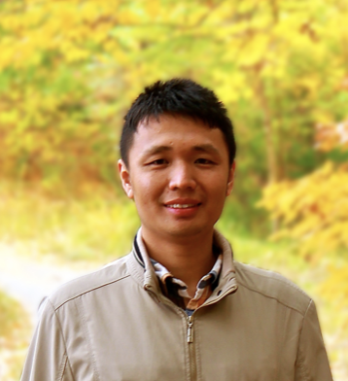
Goal
Goal: Guessing ‘s rating on the movie

Slide 4
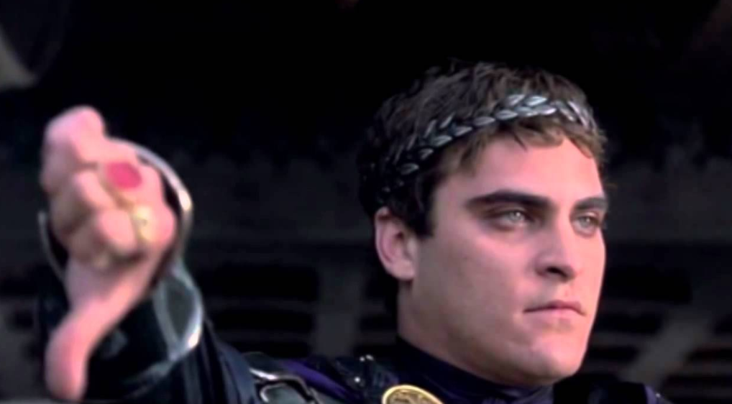


Naive Approaches
r = 𝜇 + b_i + b_u
Prediction = Avg Rating of all movies + how Magic Mike is rated overall + how Yexiang rates movies
= 3.3
0.5
0.8
= 3.6

Slide 5
Cooler approaches
Neighborhood Models
Latent factor Models

Slide 6


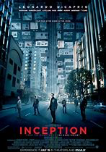

Neighborhood method
Users Movies
Observation - Yexiang and Mohit have similar tastes.
Problem Statement - Figure out Yexiang’s rating for an unseen movie (say Inception!)
Method - Take weighted average of rating given by top K similar users.
Similarity Measure - Cosine Distance etc.
Notes:
Now, an observation could be that Yexiang and Mohit might have similar tastes. In the neighbourhood method, we make use of this observation and predict unknown rating for a user to be a weighted average of top K similar users who have rated that movie. One similarity measure could be cosine distance between the users.

Slide 7
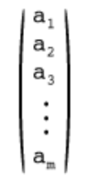
Latent Factor Method
We want to capture more information about both the item and user.

Slide 8
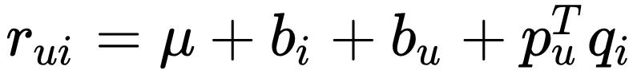
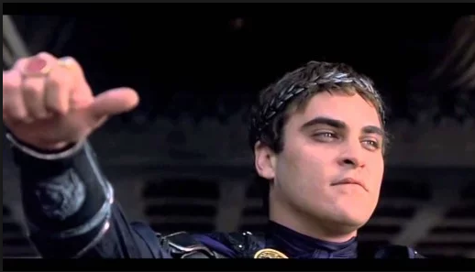

Funk SVD

Slide 9
SVD++
Implicit information
R(u) | The Notebook | Magic Mike | Lion King
Yexiang | 4 | ? | 2
N(u) | The Notebook | Magic Mike | Lion King
Yexiang | 1 | 0 | 1
Notes:
The normalization term regularize the effect of the implicit feedback

Slide 10
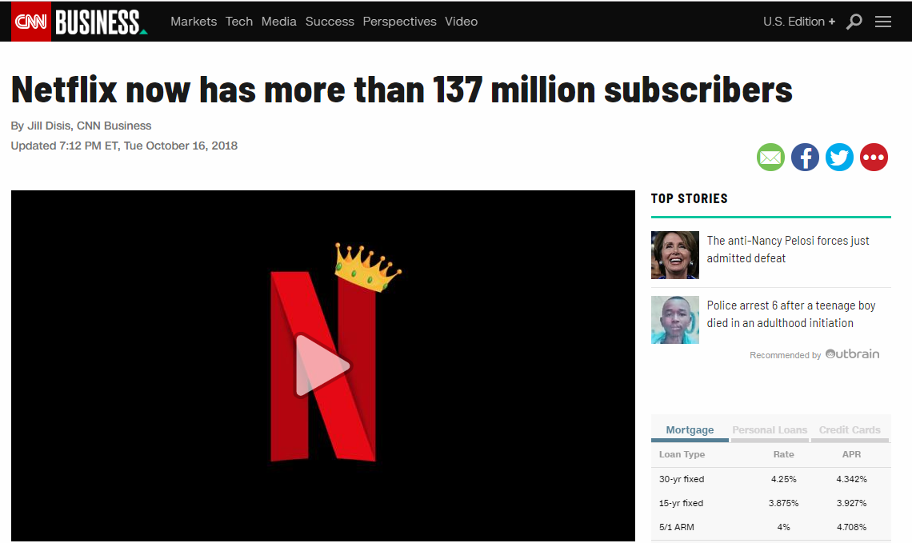
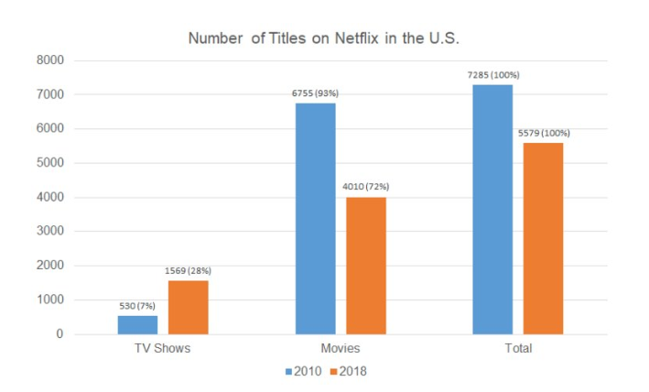
Not very practical

Slide 11

Asymmetric SVD
R(u) | The Notebook | Magic Mike | Lion King
Yexiang | 4 | ? | 2
+
……..
Notes:
So, instead of representing Yexiang as an vector, we are representing Yexiang as a linear combination of movies

Slide 12
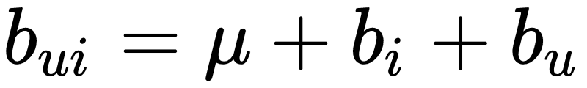
Asymmetric SVD Cont.
Notes:
So, instead of representing Yexiang as an vector, we are representing Yexiang as a linear combination of movies

Slide 13
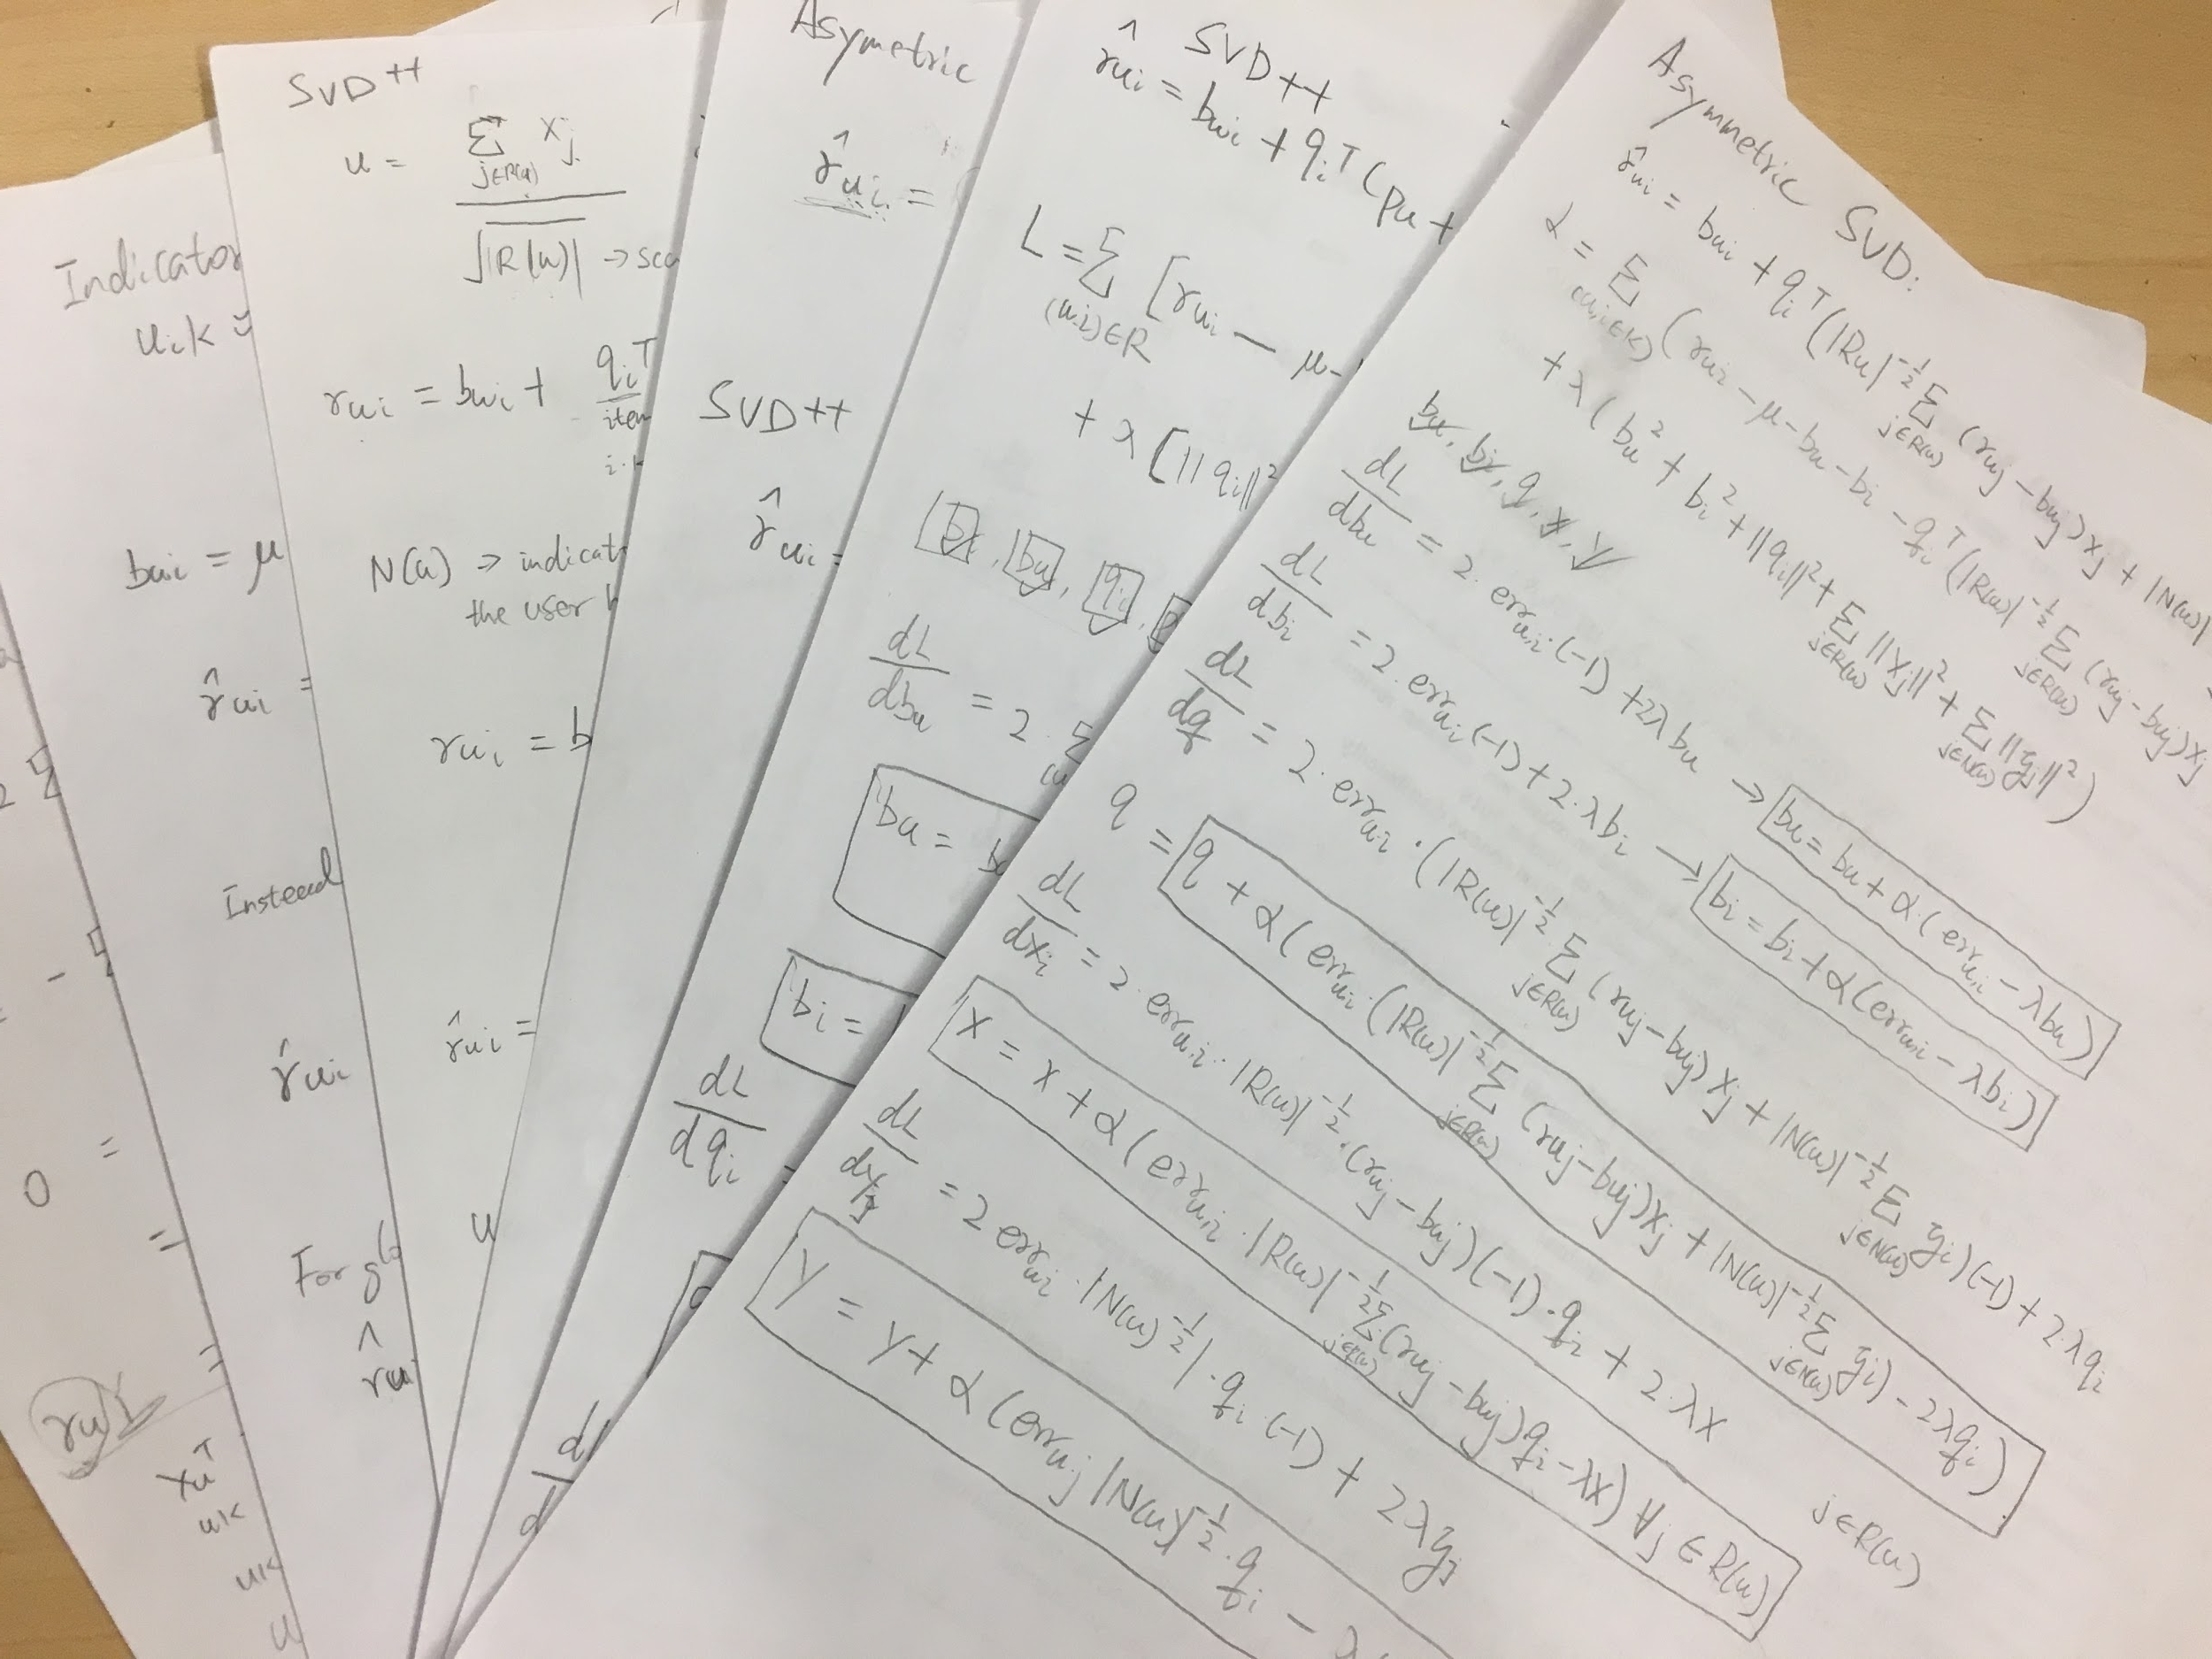
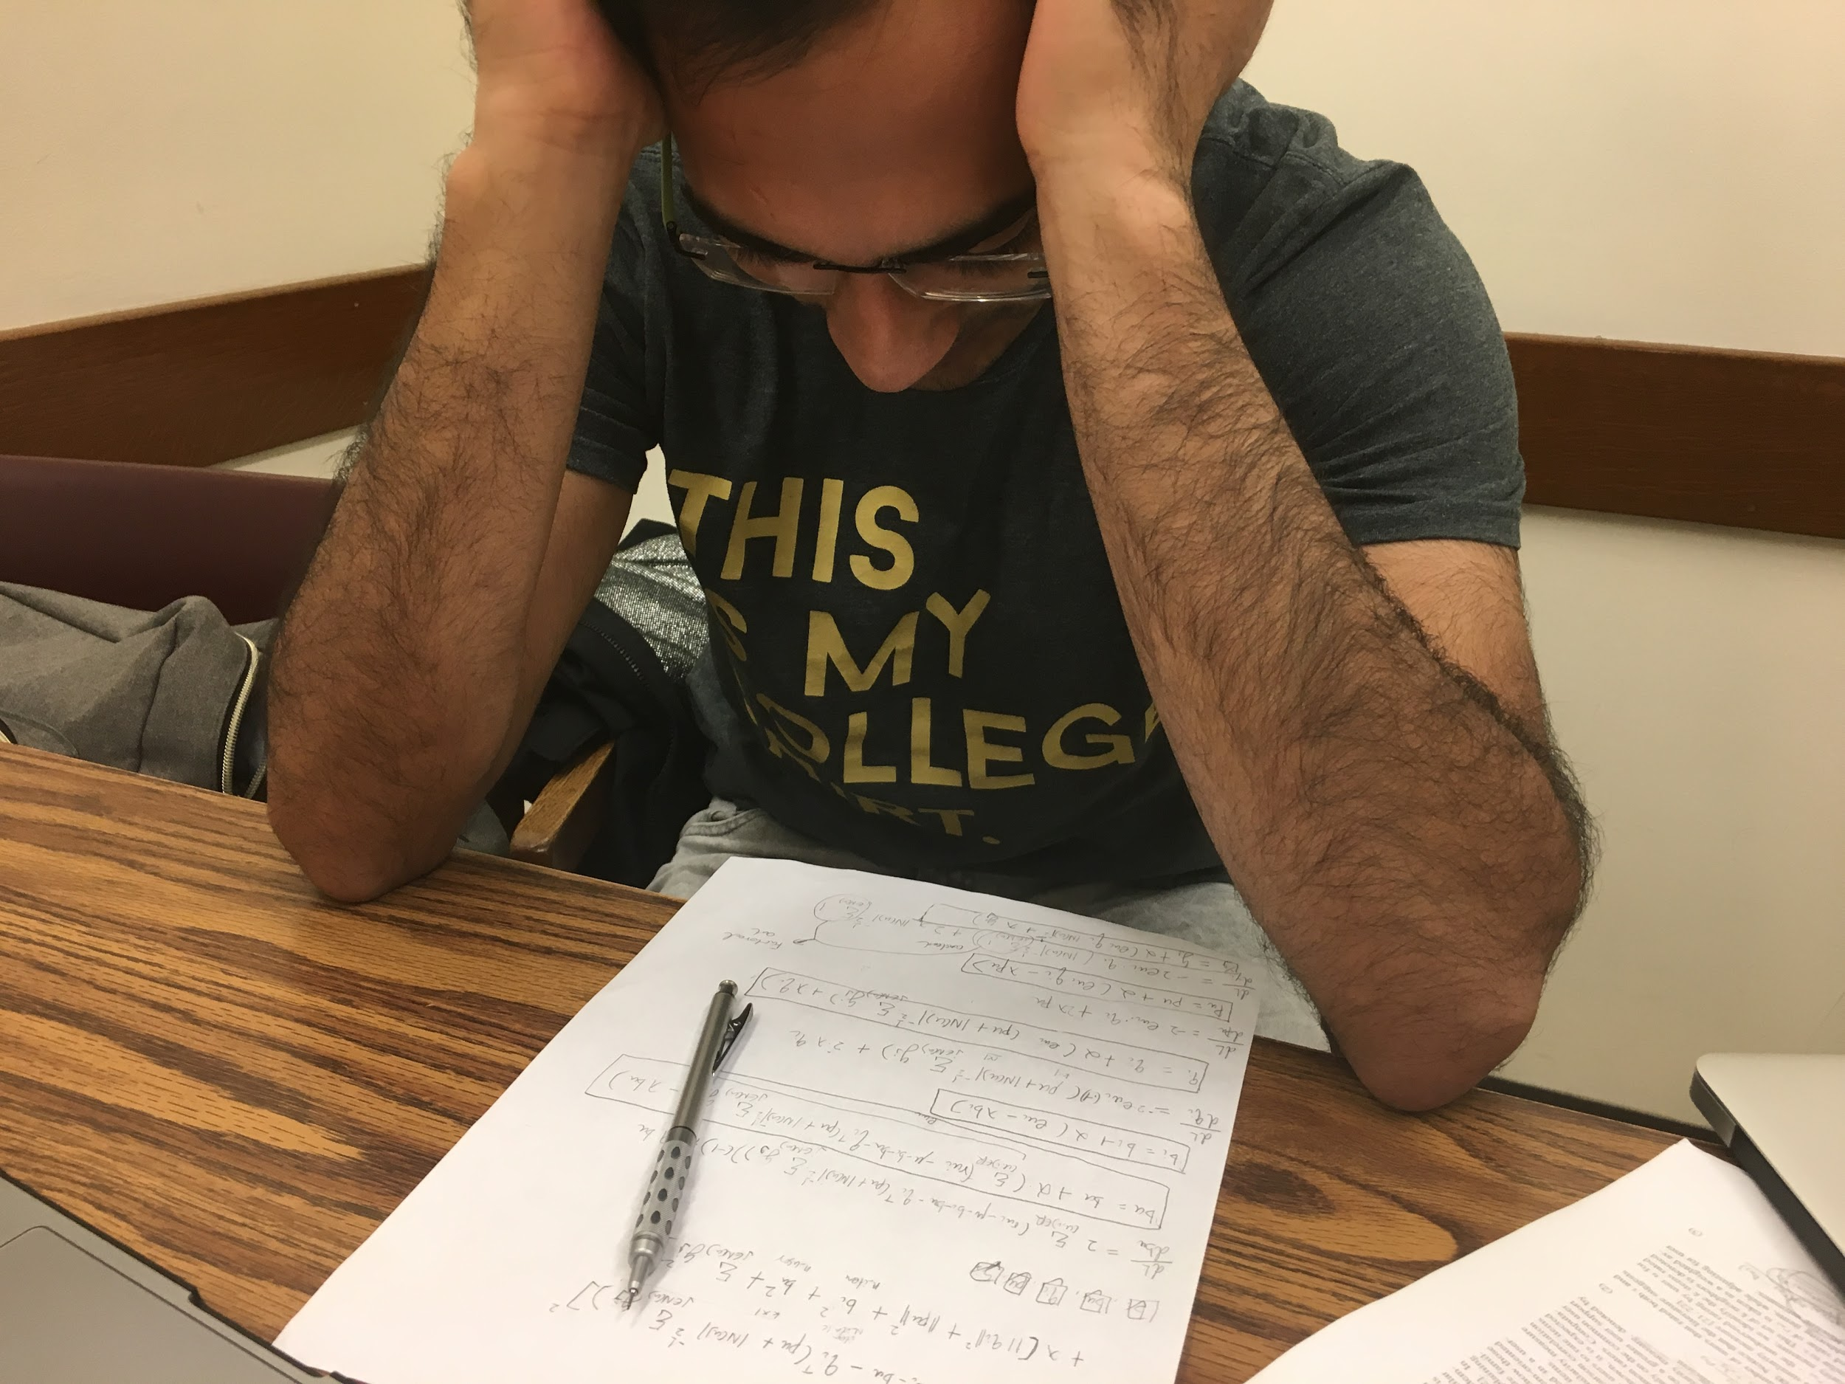
But how do you get the weights?

Slide 14
What are the results?
MSE | 10 Iterations | 50 Iterations | 100 Iterations | Best Result
Funk SVD | 1.01832 | 0.95265 | 0.93090 | 0.90125
SVD++ | 0.95797 | 0.90997 | 0.88431 | 0.88317
Asymmetric SVD | 0.95293 | 0.91231 | 0.89169 | 0.88789

Slide 15
Thank you!

